Slide 1

Institutionalizing Safeguarding In Kenya Red Cross Society
Safeguarding Risk Assessment Findings: Q4 2025

Slide 2
Objectives of the Asessment
Identify and prioritize safeguarding risks, including SEAH and child safeguarding risks, across KRCSS branches
Evaluate the effectiveness of existing safeguarding structures against internationally recognized safeguarding standards
Assess branch-compliance level with organizational safeguarding policies and donor safeguarding requirements
Establish capacity gaps in prevention, reporting, and response mechanisms
Establish a baseline for measuring safeguarding maturity improvements over time
Inform prioritization and resourcing decisions for Quarter 1–2

Slide 3
ASSESSMENT OVERVIEW
Comprehensive safeguarding risk assessment conducted across 28 KRCS branches
Assessment period: October - November 2025
Geographic coverage: 7 regions (Coast, West Kenya, Central, Upper Eastern, LLower Eastern, South Rift, North Rift)
Tool used: KRCS Safeguarding Risk Assessment Tool (adapted from IFRC Safeguarding Framework)
Data collection: Structured interviews with County Coordinators, Administrators, and Safeguarding Champions; review of board minutes, verification of training completion, Sampling of volunteer files, and IEC visibility checks and referral directories review, spot-checks of displays
Four key pillars assessed: Leadership, Recognition and Prevention, Reporting, Survivor Assistance

Slide 4
KEY FNDINGS AT A GLANCE
OVERALL RISK POSTURE: Medium (with several High-risk exposures)
STRENGTHS:
Active safeguarding champions conducting safeguarding sensitization and policy dissemination sessions.
Growing awareness of safeguarding obligations among branch leadership, staff, and volunteers.
CRITICAL GAPS:
Limited governance engagement; safeguarding is rarely discussed in Board minutes
Lack of documentation of sensitization efforts
IEC materials are absent in several branches assessed
Gaps in survivor-centered response capacity and referral pathways.
Uneven safeguarding training coverage among staff and volunteers (including mandatory courses)

Slide 5
Areas Assessed
Pillar 1: Leadership and Organizational Culture
Safeguarding is discussed in Board meetings with documented safeguarding agenda items and action points
Staff/volunteers/partners are aware of the safeguarding policies and know where to find them
Pillar 2: Recognition and Prevention
Staff/Volunteers completing mandatory safeguarding trainings and they are tracked
All staff/volunteers/ contractors sign the Code of conduct
Pillar 3: Reporting
Safeguarding IECS (PSEAH, Child Safeguarding, Reporting) available and displayed
Safeguarding awareness sessions were conducted for staff and volunteers
Pillar 4: Support to Survivors
Updated SEAH/GBV referral directories

Slide 6

SCORING CRITERIA
Scoring methodology: Three-tier rating systemm:
Score 2 (Fully compliant/Low Risk): Evidence of systematic implementation
Score 1 (Partially compliant/Medium Risk): Ad hoc implementation or incomplete evidence
Score 0 (Non-compliant/High Risk): Absence of practice or evidence
Risk Level | Score Range
Low Risk | 17–21
Medium Risk | 12–16
High Risk | 7–11

Slide 7
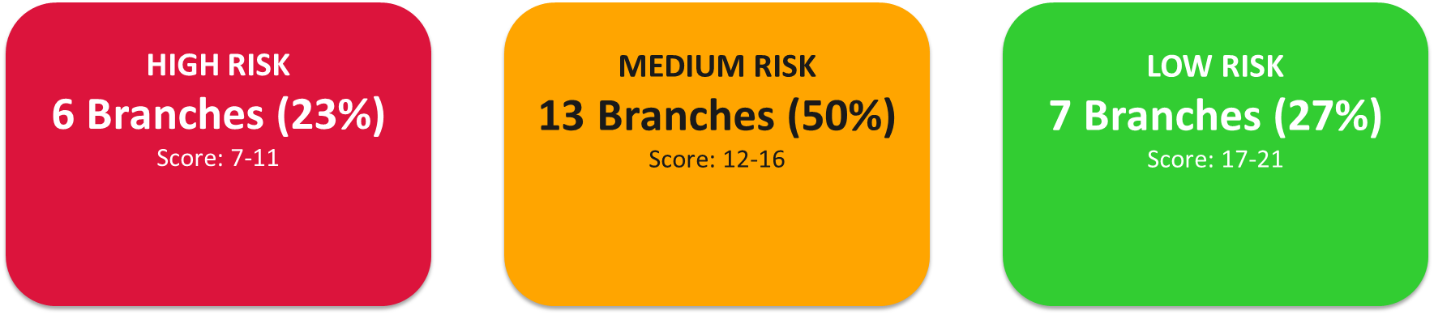
Overall Risk Distribution Across 28 Branches

Slide 8
LOW RISK BRANCHES
Mombasa | 19 | Low
Baringo | 19 | Low
Kilifi | 18 | Low
Nakuru | 18 | Low
Narok | 18 | Low
Kajiado | 17 | Low

Slide 9
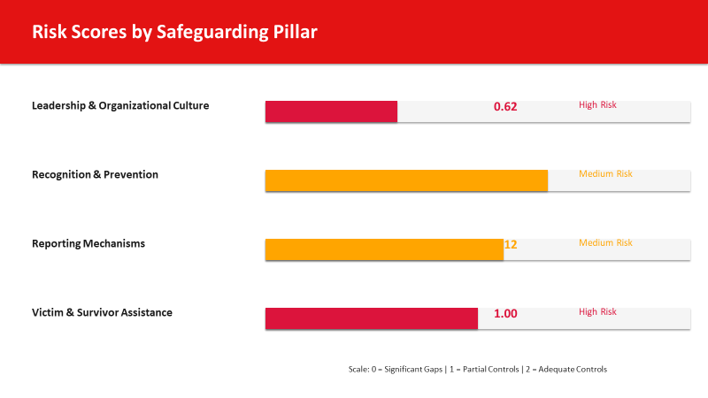

Slide 10
Recommendations
Mandate safeguarding as a standing agenda item for all board meetings with documented action points reviewed quarterly by the Board Chair.
Appoint Safeguarding Champions at Boards and Branch level
Develop Referral Directories for all branches
Tracking of the mandatory courses completion
Documentation of safeguarding sensitization sessions conducted
Include safeguarding risks in the Branch/Project Risk Registers

Slide 11
